Slide 1
MFIT5008 Group Project
The Analysis of IRR
Group Members:
LI Xinyu (20920763)
LIU Haonan (20919427)
WU Mingyu (20922890)
XU Zhizhen (20921779)
YANG Zeng (20919116)
ZHAN Jiaxin (20930988)

Slide 2
Directory
Intro & Decision rules & Pros and Cons
Multiple IRR problem
Hazon’s (2003) Criterion - Investment Stream & Fundamental Therom
Economic Interpretation and Application on Ranking Projects - Traditional IRR
Magni’s (2010) AIRR & Criterion
Residual Income & Economic Interpretation & Ranking Project
Benefits and Limitations of AIRR
Conclusion

Slide 3
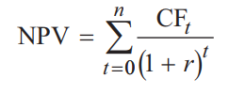
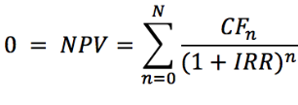
Introduction
The internal rate of return (IRR) is a metric used in financial analysis to estimate the profitability of potential investments.
IRR is a discount rate that makes the net present value (NPV) of all cash flows equal to zero in a discounted cash flow analysis.
IRR calculations rely on the same formula as NPV does.

Slide 4

Decision Rules
Invest in the project if:
IRR > r
Do not invest if:
IRR < r
where r is the required rate of return (normally the cost of capital to fund the project)

Slide 5
Pros and Cons
The IRR for each project under consideration by your business can be compared and used in decision-making.
Advantage: Finds the Time Value of Money
Advantage: Simple to Use and Understand
Advantage: No Need to Recalculate When R Changes
Notes:
Internal rate of return is measured by calculating the interest rate at which the present value of future cash flows equals the required capital investment. The advantage is that the timing of cash flows in all future years are considered and, therefore, each cash flow is given equal weight by using the time value of money.
The IRR is an easy measure to calculate and provides a simple means by which to compare the worth of various projects under consideration. The IRR provides any small business owner with a quick snapshot of what capital projects would provide the greatest potential cash flow. It can also be used for budgeting purposes such as to provide a quick snapshot of the potential value or savings of purchasing new equipment as opposed to repairing old equipment.
In capital budgeting analysis, the hurdle rate, or cost of capital, is the required rate of return at which investors agree to fund a project. It can be a subjective figure and typically ends up as a rough estimate. The IRR method does not require the hurdle rate, mitigating the risk of determining a wrong rate. Once the IRR is calculated, projects can be selected where the IRR exceeds the estimated cost of capital.
A disadvantage of using the IRR method is that it does not account for the project size when comparing projects. Cash flows are simply compared to the amount of capital outlay generating those cash flows. This can be troublesome when two projects require a significantly different amount of capital outlay, but the smaller project returns a higher IRR.
For example, a project with a $100,000 capital outlay and projected cash flows of $25,000 in the next five years has an IRR of 7.94 percent, whereas a project with a $10,000 capital outlay and projected cash flows of $3,000 in the next five years has an IRR of 15.2 percent. Using the IRR method alone makes the smaller project more attractive, and ignores the fact that the larger project can generate significantly higher cash flows and perhaps larger profits.
The IRR method only concerns itself with the projected cash flows generated by a capital injection and ignores the potential future costs that may affect profit. If you are considering an investment in trucks, for example, future fuel and maintenance costs might affect profit as fuel prices fluctuate and maintenance requirements change. A dependent project may be the necessity to purchase vacant land on which to park a fleet of trucks, and such cost would not factor in the IRR calculation of the cash flows generated by the operation of the fleet.
Although the IRR allows you to calculate the value of future cash flows, it makes an implicit assumption that those cash flows can be reinvested at the same rate as the IRR. That assumption is not practical as the IRR is sometimes a very high number and opportunities that yield such a return are generally not available or significantly limited.

Slide 6
Pros and Cons
Disadvantages: IRR
implicitly assumes that you can reinvest cash flows at that same discount rate, ignoring future costs, which is unrealistic
neglects the length, and the size (monetary amount) of project
multiple/no IRR problem for traditional finance
Notes:
Internal rate of return is measured by calculating the interest rate at which the present value of future cash flows equals the required capital investment. The advantage is that the timing of cash flows in all future years are considered and, therefore, each cash flow is given equal weight by using the time value of money.
The IRR is an easy measure to calculate and provides a simple means by which to compare the worth of various projects under consideration. The IRR provides any small business owner with a quick snapshot of what capital projects would provide the greatest potential cash flow. It can also be used for budgeting purposes such as to provide a quick snapshot of the potential value or savings of purchasing new equipment as opposed to repairing old equipment.
In capital budgeting analysis, the hurdle rate, or cost of capital, is the required rate of return at which investors agree to fund a project. It can be a subjective figure and typically ends up as a rough estimate. The IRR method does not require the hurdle rate, mitigating the risk of determining a wrong rate. Once the IRR is calculated, projects can be selected where the IRR exceeds the estimated cost of capital.
A disadvantage of using the IRR method is that it does not account for the project size when comparing projects. Cash flows are simply compared to the amount of capital outlay generating those cash flows. This can be troublesome when two projects require a significantly different amount of capital outlay, but the smaller project returns a higher IRR.
For example, a project with a $100,000 capital outlay and projected cash flows of $25,000 in the next five years has an IRR of 7.94 percent, whereas a project with a $10,000 capital outlay and projected cash flows of $3,000 in the next five years has an IRR of 15.2 percent. Using the IRR method alone makes the smaller project more attractive, and ignores the fact that the larger project can generate significantly higher cash flows and perhaps larger profits.
The IRR method only concerns itself with the projected cash flows generated by a capital injection and ignores the potential future costs that may affect profit. If you are considering an investment in trucks, for example, future fuel and maintenance costs might affect profit as fuel prices fluctuate and maintenance requirements change. A dependent project may be the necessity to purchase vacant land on which to park a fleet of trucks, and such cost would not factor in the IRR calculation of the cash flows generated by the operation of the fleet.
Although the IRR allows you to calculate the value of future cash flows, it makes an implicit assumption that those cash flows can be reinvested at the same rate as the IRR. That assumption is not practical as the IRR is sometimes a very high number and opportunities that yield such a return are generally not available or significantly limited.

Slide 7
Multiple IRR Problem
Let x = 1+IRR; Solving the IRR for period 0 to N is equivalent to Solving a polynomial equation of degree N
There are at most N roots (including complex numbers)
No more real solutions than the number of cash flow sign changes
For example, a project with two sign changes could have 0, 1, or 2 IRRs

Slide 8
Multiple IRR Problem
For conventional projects (negative cash flows followed by positive cash flows), no Multiple IRR problem (meaning no different solutions)
For non-conventional cash flows, traditional finance is unable to interpret multiple or no (real) IRRs → prefer NPV method
Tools like Financial calculators or Excel are unable to produce meaningful results
Hazen (2003) provided a new perspective

Slide 9
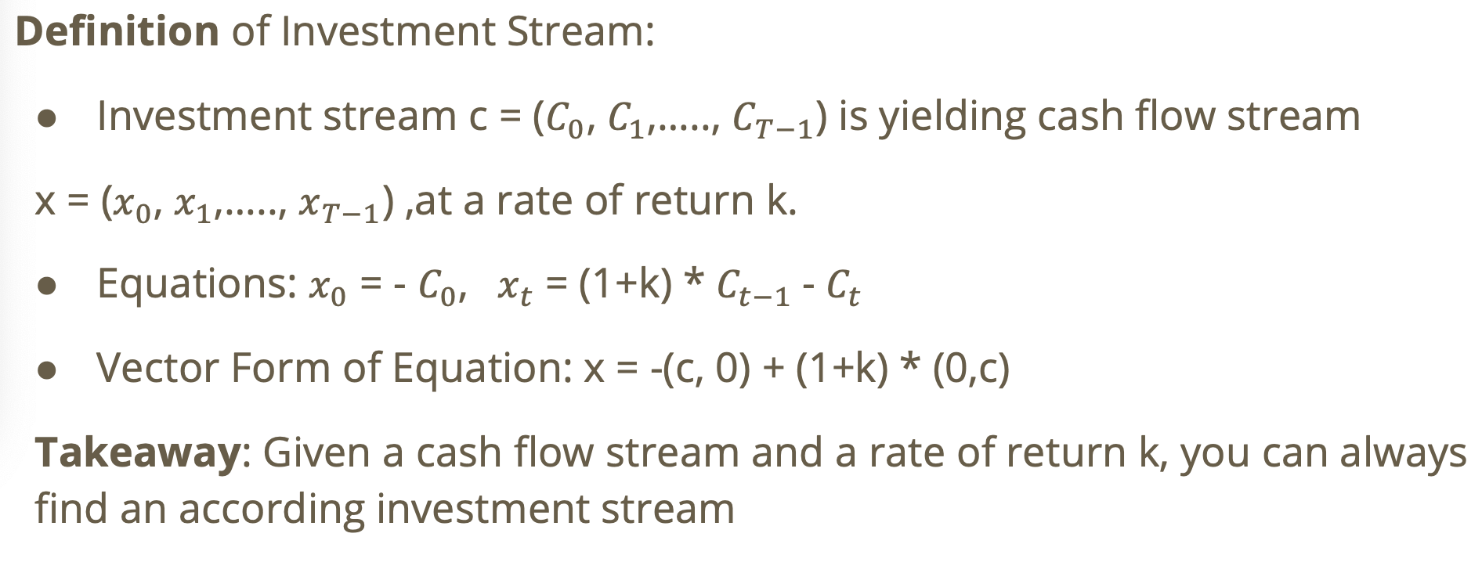

Hazon’s (2003) Criterion - Investment Stream

Slide 10
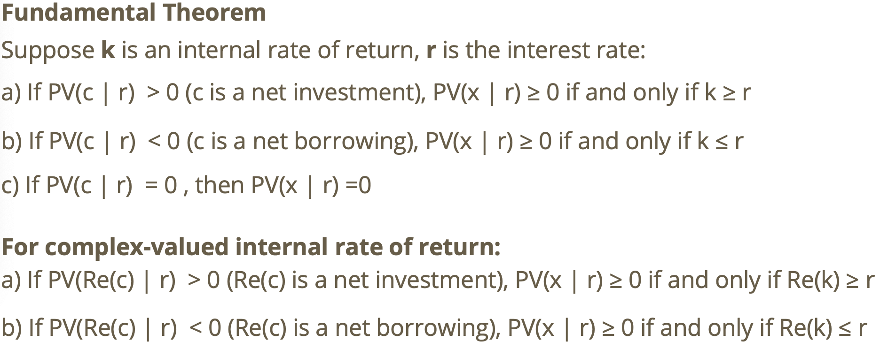
Hazon’s (2003) Criterion - Fundamental Therom

Slide 11
Economic Interpretation and Application on Ranking Projects - Traditional IRR
The only Economic Interpretation of traditional IRR:
Greater the IRR, Smaller the net investment magnitude (present value of investment stream).
Application on ranking projects:
Use IRR only when net investment PV(c | r) of two projects are equal
When net investments are very different, IRR gives little information (Again, net investment magnitude must be considered)
Conclusion on Hazon’s (2003) Criterion:
Proves that all IRRs are equally valid
NPV method is still the go-to choice; no change to the real world practice

Slide 12
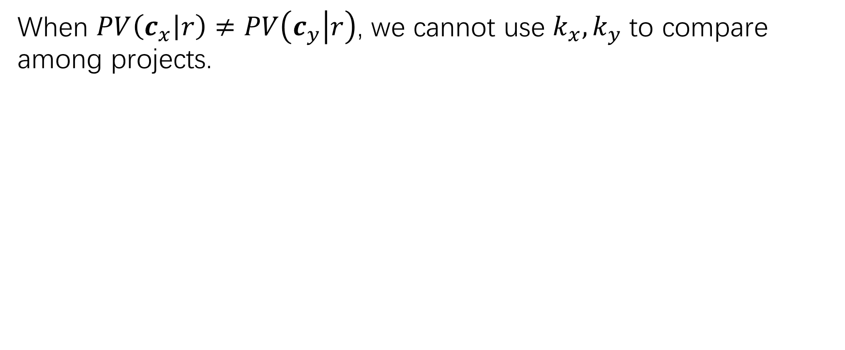
Magni’s (2010) AIRR
Hazon’s (2003) criterion brilliantly solves the problem of multiple roots.
However, it cannot solve the following problems:
No economic interpretation of such complex-valued IRR and the corresponding complex-valued investment streams.
Hard to justify any economic recommendation.
Magni’s (2010) Average internal rate of return deals with the above issues.
Notes:
Thank Owen for demonstrating on Hazon’s Criterion. It solves the problem of multiple roots IRR and gives a non-contradictory and NPV-consistent usage of it. However, there are still some problems: The complex-valued IRR and corresponding investment streams are mathematically consistent to the real-valued ones, but they don’t have any economic interpretation. This weakens the result and it is hard to justify any economic recommendation. What’s more, when doing the projects ranking, this criterion only work when the present value of investment stream are the same. When 2 projects have different investment stream, it fails to do the comparison. Magni’s Average internal rate of return solves the problems above.

Slide 13
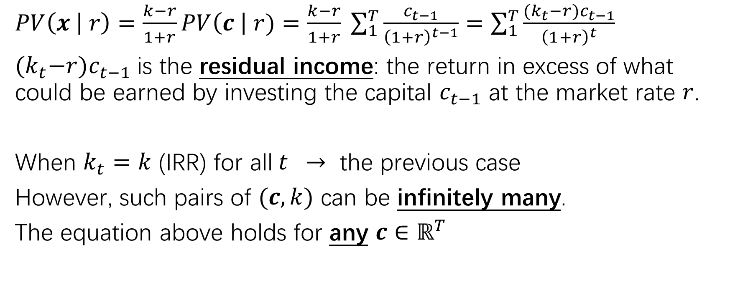
Residual Income
Notes:
First we introduce the residual income. From Hazon’s criterion, we can write the NPV in this particular form and we can change the k to kt for each time period. Here, kt minus r times ct minus 1 is the return in excess of what could be earned by investing the capital ct minus 1 at the market rate r, which is the residual income. The previous case set kt to be the IRR for all t, however, this equation holds for any investment stream c and such pairs of c and k can be infinitely many.

Slide 14
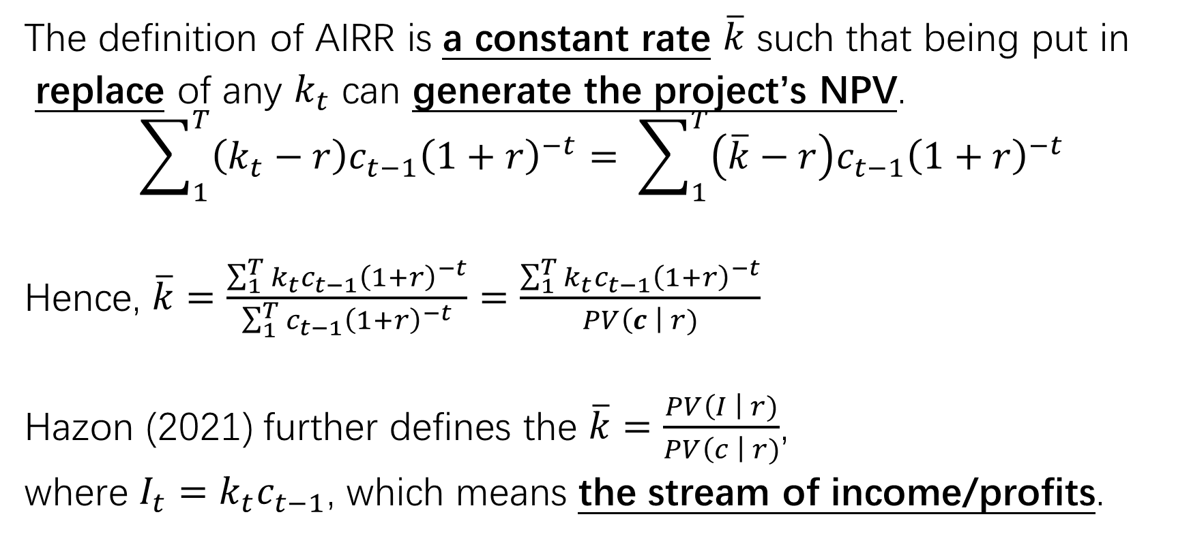
Magni’s (2010) AIRR
Notes:
AIRR is the constant rate which can replace all kt to generate the project’s NPV. This is the calculation of k bar. It is a capital-weighted average of each kt
Hazon further utilize the AIRR definition to define it as the present value of the steam of income divided by the present value of investment stream.

Slide 15
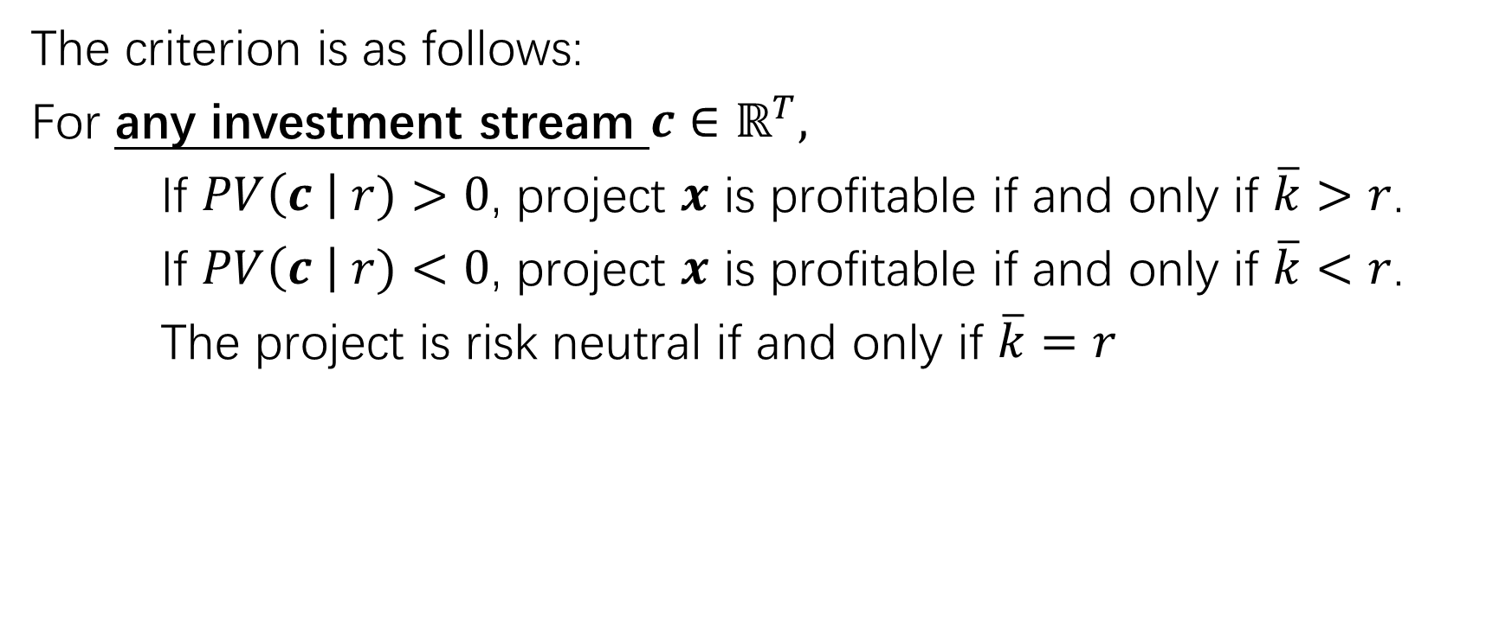
Magni’s (2010) AIRR Criterion
Notes:
The criterion of AIRR is quite similar to the Hazon’s criterion. the project is profitable when present value of investment stream is larger than 0 and k bar is larger than the market rate r at the same time, or when they are both smaller.

Slide 16
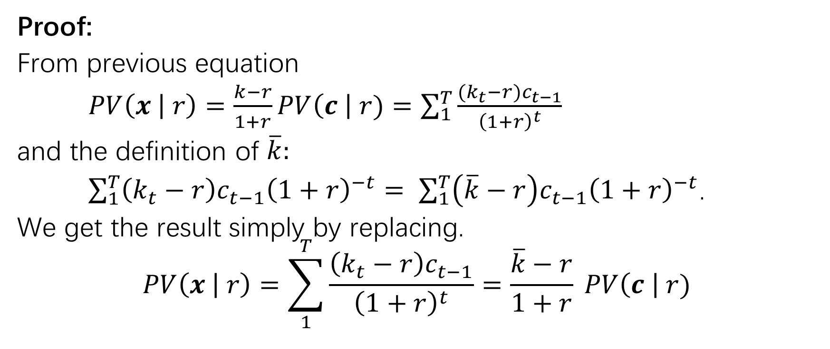
Magni’s (2010) AIRR Criterion
Notes:
The proof is simply by replacement, and we get the similar equation as the Hazon’s Criterion

Slide 17
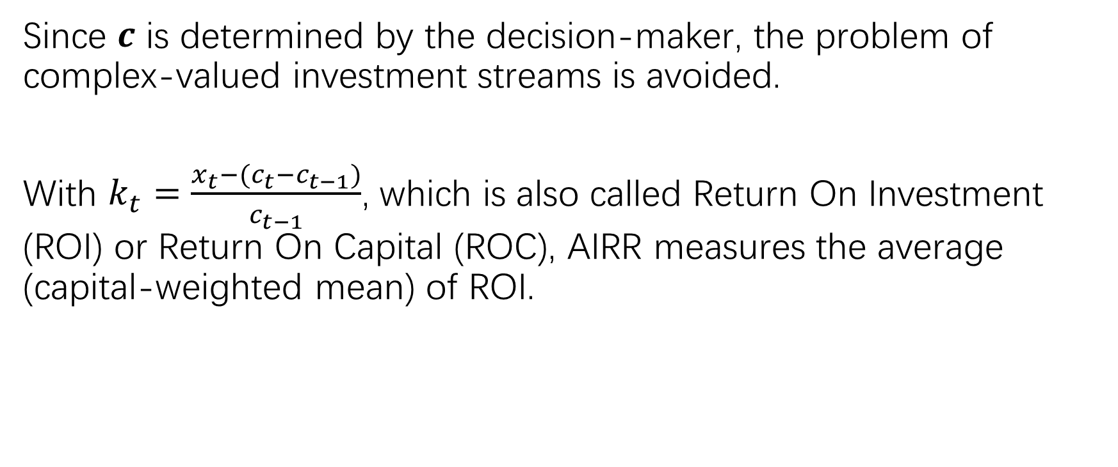
Economic Interpretation
Notes:
Here, investment cash flow can be decided manually, so no worries on the complex number. Furthermore, the kt is regarded as the ROI and Average internal rate of rate measures the capital-weighted mean of ROI

Slide 18
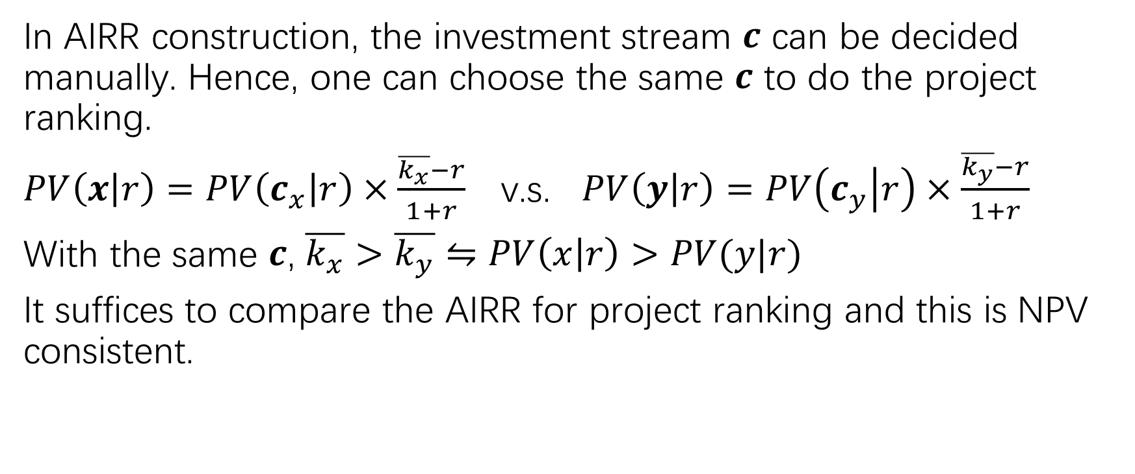
Ranking Project
Notes:
We have discussed that when present value of investment stream are different, we cannot do the project ranking. By manually setting the investment stream the same, we can compare different project and this outcome is NPV consistent even for mutually exclusive projects.
Now I will pass the time to HAONAN to discuss the limitation of IRR with you.

Slide 19

Benefits Of AIRR
The previous limitations can be avoided by the AIRR:
By the definition of AIRR: all the outputs will be real-valued internal rates.
Because the extended AIRR is NPV consistent, there can be no conflict with NPV (or in the risk-neutral case, expected NPV) in the stochastic project.

Slide 20
The Limitation Of AIRR
As the definition of AIRR, if the present value of investment stream c = 0, the AIRR does not exist.
Need a lot of estimations: need to decide investment stream c and market rate r.
Once the market rate r is changed, everything needs to be recalculated; while traditional IRR does not require recalculation.
Economic meaning is not as trivial as IRR → hard to explain to investors

Slide 21
Conclusion
IRR can be analyzed after the investment stream is categorized as net investment / net borrowing.
Uniquely extending the AIRR to risky projects evaluated under an expected utility approach to bypass the issue of risky cash flows, where the IRR is known to be inconsistent or possibly nonexistent.
The extended AIRR/IRR is used not to replace but to supplement the expected NPV, in order to give further insight into the scale and the economic efficiency of a risky project.

Slide 22

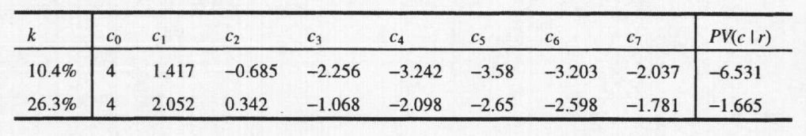
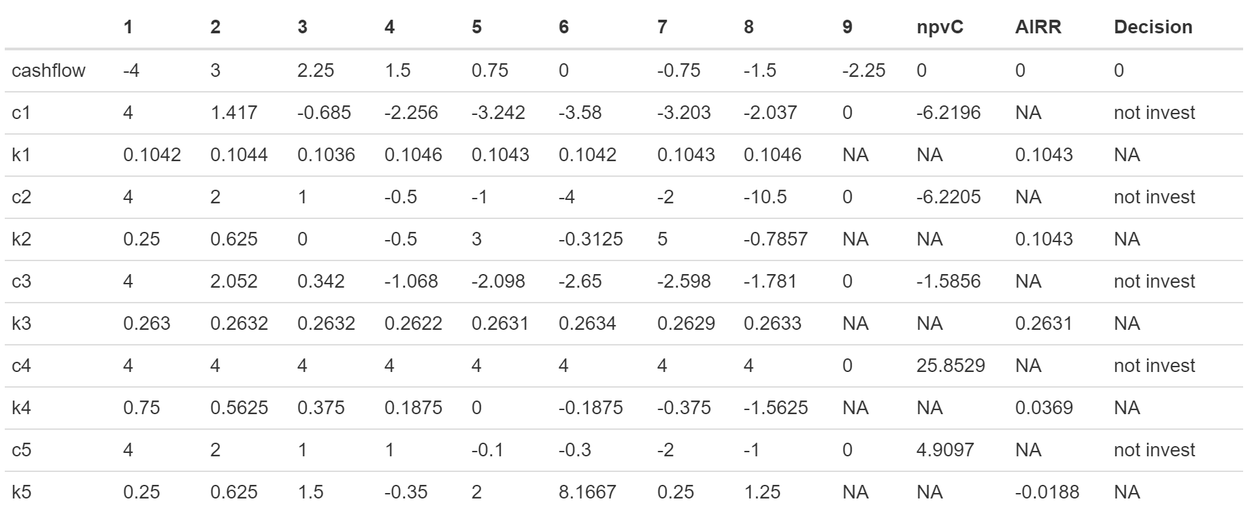
AIRR-tool output
NPV = -0.3378 at r = 0.05; not invest
√
√
√
√
√

Slide 23
R Tool Demonstration

